Slide 1
Answer the following on the top of your piece of paper
Have you ever felt that someone was unfair to you and no one stood up for you? What did you do? How did it make you feel?

Slide 2
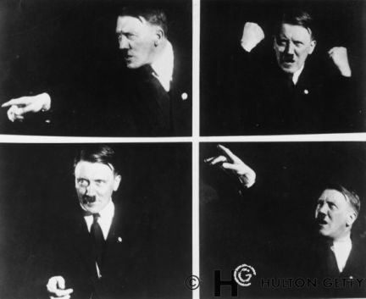
Hitler and the Rise of Nazi Germany

Slide 3
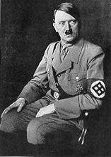
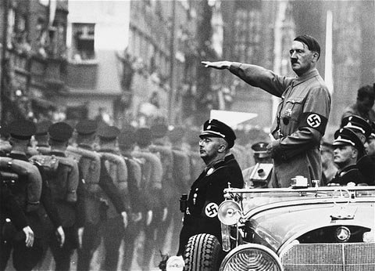
The Rise of Adolf Hitler
Born in Austria in 1889
He attempted to seize power in 1923 and failed. He was put in jail. While in prison he wrote Mein Kampf (My Struggle) which outlined the goals and ideology of the Nazi party.

Slide 4
Goals and Ideology of the Nazis
Extreme nationalism
Racism
Anti-Semitism – Hitler believed Germans belonged to a superior “master race” called Aryans (light skinned Europeans). Greatest enemies were the Jews. Hitler believed Jews were not a different religion but a different race
The word "swastika" comes from the Sanskrit svastika - "su" meaning "good," "asti" meaning "to be," and "ka" as a suffix.

Slide 5
How Hitler came to be in power
Great Depression was very hard on the German people (as unemployment rose, Nazi membership grew to ~ 1 million)
Promised to end reparations, create jobs, and rearm Germany
Elected chancellor by other members of the government (came to power legally)
Wanted to create a German master race.

Slide 6
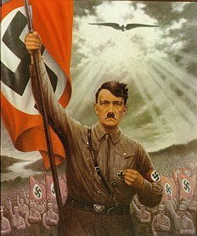
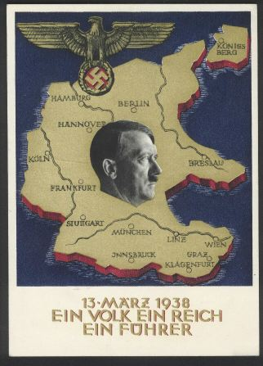
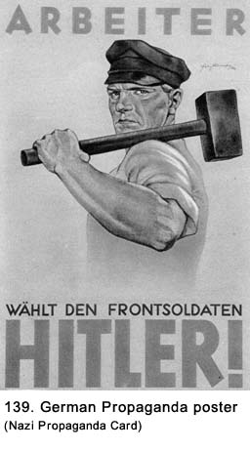
Use of Propaganda

Slide 7
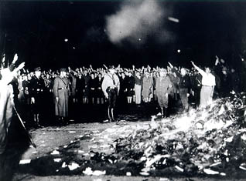
Purging German Culture
No modern art or music because it was corrupted by Jewish influence
Textbooks were rewritten to reflect Nazi racial views
Burned books, including All Quiet on the Western Front (it was an insult to the German military) and many others.
Sought to stop Christianity
by closing churches and
silencing clergy
*Used the Gestapo
(secret police) to enforce his will

Slide 8
Hitler begins his campaign against the Jews
1935 – Nuremburg Laws placed severe restrictions on Jews
Prohibited from marrying non-Jews
Prohibited from attending or teaching at German schools or universities
Prohibited from holding government jobs
Prohibited from practicing medicine or law
Prohibited from publishing books
Nazis beat and robbed Jews and gathered mobs to join in.
Many Jews, including Albert Einstein, fled to other countries

Slide 9
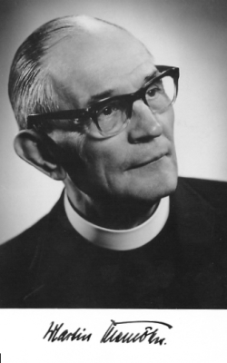
Quote from Martin Niemoller, a German Protestant minister
“The Nazis came first for the Communists. But I wasn’t a Communist, so I didn’t speak up. Then they came for the Jews, but I wasn’t a Jew so I didn’t speak up. Then they came for the trade unionists. But I wasn’t a trade unionist so I didn’t speak up. Then they came for the Catholics, but I was a Protestant so I didn’t speak up.
Then they came for me. By that time,
there was no one left to speak up.”

Slide 10
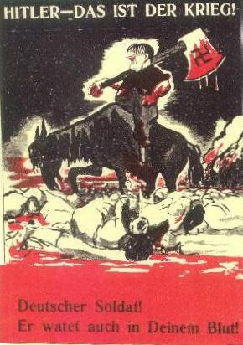
Holocaust –
mass
destruction
of the
European
Jewish
people based on racial grounds by the Nazi’s in World War II.

Slide 11
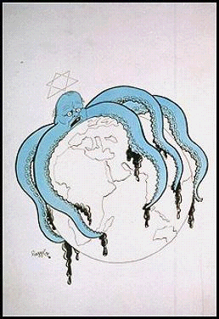
Anti -Semitism
This is the term given to political, social and economic agitation against Jews.
Aryan Race
This was the name of what Hitler believed was the perfect race. These were people with full German blood, blonde hair and blue eyes.

Slide 12
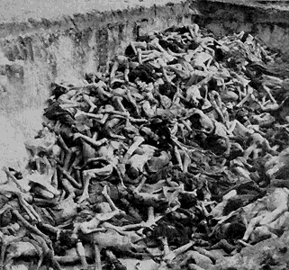
Between 1939 and 1945 six million Jews were murdered, along with Millions of others, such as Gypsies, Jehovah’s Witnesses, disabled and the mentally ill.

Slide 13
Percentage of Jews killed in each country
POLAND 91%
AUSTRIA 35%
USSR 36%
BELGIUM 45%
NORWAY 45%
LUXEMBOURG 55%
ROMANIA 84%
ESTONIA 44%
A Total of 6,000,000 Jews
HUNGARY 74%
BOHEMIA 60%
YUGOSLAVIA 81%
LATVIA 84%
NETHERLANDS 71%
LITHUANIA 85%
GERMANY 36%
FRANCE 22%
GREECE 87%
Notes:
How did they manage to get together all these Jews to kills them?
How did they kill them when they had them?
To begin with there were concentration camps.

Slide 14
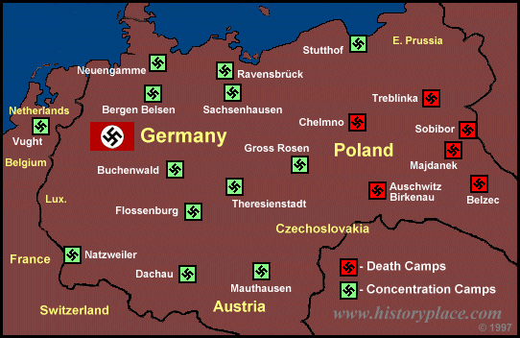
A MAP OF THE CONCENTRATION CAMPS AND DEATH CAMPS USED BY THE NAZIS.
Notes:
There were concentration camps and death camps. If you went to a death camp the chances of coming out alive were virtually nil.
Even at concentration camps though you were likely to die from the appalling conditions.
Or, if you were very young, old, or incapable of hard labour, it was likely you would be transferred to a death camp too.
Anne Frank died at Belsen from Typhoid.
Leonard Leher's mother and sisters were sent to Sobibor.
YOU MAY ASK "WHO WERE THESE PEOPLE WHO WERE SENT TO PLACES LIKE THIS?"
THEY WERE CHILDREN JUST LIKE YOU. THE ONLY DIFFERENCE WAS THEIR RACE AND THE RELIGION THEY FOLLOWED.

Slide 15
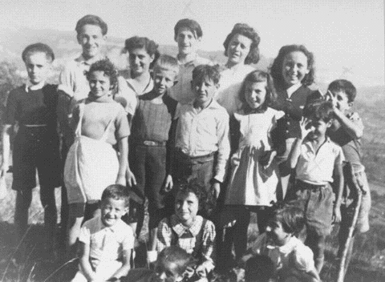
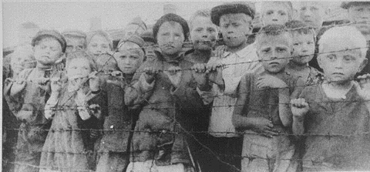
16 of the 44 children taken from a French children’s home.
They were sent to a concentration camp and later to Auschwitz.
ONLY 1 SURVIVED
A group of children at a concentration camp in Poland.
Notes:
HOW DID THEY KILL THESE INNOCENT CHILDREN, ALONG WITH THEIR PARENTS, GRANDPARENTS, FRIENDS ETC..
YOU WILL ALL HAVE PROBABLY HEARD OF THE WAY NAZiS GASSED THE JEWS.

Slide 16
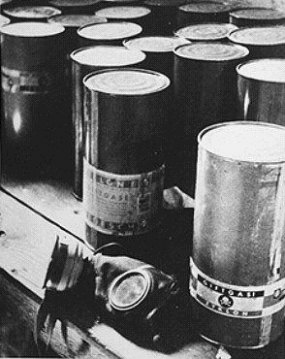
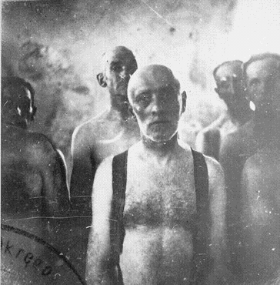
Part of a stockpile of Zyklon-B poison gas pellets found at Majdanek death camp.
Before poison gas was used , Jews were gassed in mobile gas vans. Carbon monoxide gas from the engine’s exhaust was fed into the sealed rear compartment. Victims were dead by the time they reached the burial site.
Notes:
THIS IS THE GAS THAT WAS INTRODUCED IN 1942.
JEWS WERE SENT INTO SEALED SHOWER UNITS ON THE PRETENCE THAT THEY WERE GOING TO BE SHOWERED. PELLETS WERE THEN PLACED INTO THE SHOWER HEADS AND GAS CAME FROM THE SHOWERS INSTEAD OF WATER.
15 MINUTES LATER THE SHOWER ROOM WOULD BE EMPTIED, BODIES WERE ALWAYS IN A PYRAMID SHAPE, PEOPLE TRIED TO CLIMB ON TOP OF ONE ANOTHER TO ESCAPE THE GAS.
BEFORE THIS TYPE OF KILLING METHOD WAS INTRODUCED THOUGH A MORE PRIMITIVE GASSING METHOD WAS USED....
I DON'T KNOW HOW, OR EVEN WHY THIS PHOTO WAS TAKEN, BUT IT SHOWS SOME MEN AWAITING DEATH ON THEIR WAY TO THEIR BURIAL PLACE.
DID THEY ALWAYS BURY THE DEAD?

Slide 17
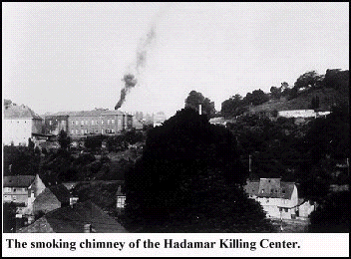
Smoke rises as the bodies are burnt.
Notes:
NO.
MORE OFTEN THAN NOT, ESPECIALLY WHEN THE NUMBER OF PEOPLE MURDERED GREW ESPECIALLY HIGH, NAZIS BURNED THE BODIES.
SO WHAT OTHER METHODS WERE USED TO SYSTEMATICALLY MURDER THESE PEOPLE?

Slide 18
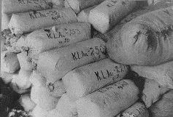
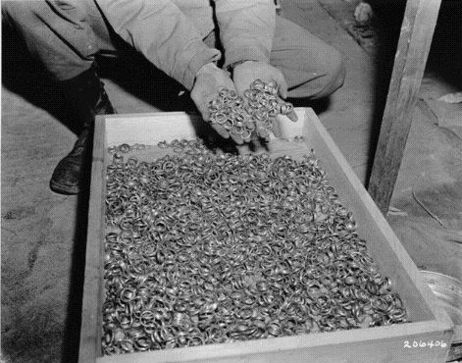
Bales of hair shaven from women at Auschwitz, used to make felt-yarn.
After liberation, an Allied soldier displays a stash of gold wedding rings taken from victims at Buchenwald.
Notes:
THESE PICTURES SHOW WHAT THEY WANTED.
WERE THE NAZI'S NOT WORRIED ABOUT THE CONSEQUENCES OF THEIR ACTIONS?
DID THEY NOT THINK ABOUT WHAT MIGHT HAPPEN IF ALLIED COUNTRIES DISCOVERED WHAT WAS HAPPENING?

Slide 19
Holocaust Video

Slide 20
Exit Ticket
Before you leave the room today, you must fill out the last page of your packet and hand it to me.
List 3 facts you learned today
List 2 things that really shocked or surprised you.
List 1 element of the Holocaust that you would like to know more about.

